Slide 1



Basic Audit Logging Patterns (BALP)
John Moehrke
By Light Professional IT Services LLC

Slide 2
The Problem
The FHIR AuditEvent and DICOM AuditMessage are a foundation for logging events such as Security, Privacy, or other log worthy events.
→ But they are too flexible
The FHIR REST model is a reusable data access pattern.
→ Need for consistency for logging use
Security tokens are used with data access
→ Consistency in logging security token details
Patient data are accessed using FHIR REST
→ Need Privacy transparency on how data are used

Slide 3
The Needs
The Basic Audit Logging Patterns (BALP) Implementation Guide provides some profiles of FHIR AuditEvent that are reusable patterns.
Consistency for logging when FHIR REST actions happen
Create, Read, Update, Delete, and Search
Consistency in logging security token details
oAuth, and SAML
Privacy transparency
A Patient’s data are used
Consent impacted authorization
Details on Disclosure

Slide 4
Existing Efforts
IHE governance and process requests that an IHE-Profile (Implementation Guide) include a Security Considerations section and further refine the Audit Log requirements. Thus many IHE-Profiles exist with refined Audit Log requirements, but this is not universal across all of IHE-Profiles. This is also not specified elsewhere.
Further within IHE the consistency of Audit Log requirements is inconsistent.
BALP is expected to be used by these other IHE-Profiles. Further refinement is expected, but use of BALP will drive consistency.

Slide 5
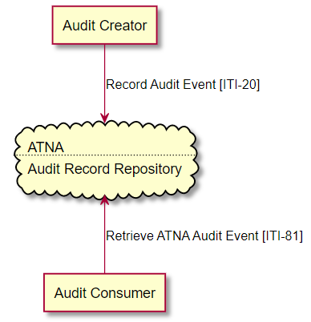
Actors
Leveraged ATNA (RESTful supplement) as the transport and query model

Slide 6
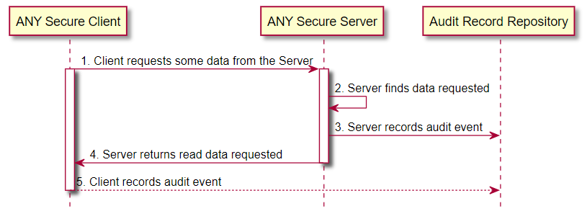
REST event
REST event | basic profile | with patient | examples
Create (create) | Create | PatientCreate | examples
Read (read and vread) | Read | PatientRead | examples
Update (update, patch) | Update | PatientUpdate | examples
Delete (delete) | Delete | PatientDelete | examples
Execute (search and query) | Query | PatientQuery | examples
Does not address how to log a failure attempt the RESTful event.

Slide 7
Security Token use
Given that a security/privacy relevant event is being recorded in the log,
When that event is authorized by an oAuth or SAML security token
Then sufficient details from the security token are included in the audit log of the event.
Minimal – preserve identifiers/references only
Comprehensive – preserves as much as possible

Slide 8
Privacy transparency
REST activities + Patient is a data/activity subject
→ patient is placed into well-known position
Authorization based on a Consent
→Access Control decision is logged with details to the patient and Consent
Privacy Disclosure
→ Who released, When, to Whom, What, and Why

Slide 9
Reuse
Currently being integrated into
MHD, PDQm, PIXm, PMIR, mCSD, SVCM
Trend
Add a subtype to indicate the transaction number
Add comment on client/server to IHE-Profile actor

Slide 10
Questions
Basic AuditEvent Log Patterns
https://profiles.ihe.net/ITI/BALP
All IHE IT-Infrastructure publications
https://profiles.ihe.net/ITI

